Slide 1
Sorting Materials into Groups

Slide 2
Geetha woke up in the morning and went to the kitchen to prepare coffee for which she used the kettle, the coffee powder, the sugar and a filter to filter the dust. From the above content we are able to understand that , Geetha had used different things which are solids but made up of different materials, even though all are solids they are not similar, but all are made up of matter. What is a matter?​

Slide 3
They are used to make different kinds of things or objects they use.​
Same objects can be made from different kinds of material.​
​
​
​
Several objects can be made by combination of many materials.​
​

Slide 4
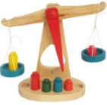
How materials are alike…​How materials are alike…​
They have the same properties like the volume and the mass.​
Volume: The amount of space the object occupies.​
Mass: The amount of matter in a object.

Slide 5
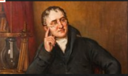
What is a Matter?
Anything that has a mass and occupies space is called a matter. ​
Eg: Book, bone, muscles, pen, etc.​
Not only the solids, the Air you breathe and the Water that we drink are matters.​
John Dalton a scientist of 19th century named the smaller unit of mater as ATOM.​
Where, when a magnets are broken they are broken into smaller magnet and when further broken they become much smaller but they are magnets. At the end they from Magnet ATOMS.​
Gold a gold atom, etc ​

Slide 6
Atoms…​
They are smaller units matter.​
Gold atom is gold, iron atom is iron.​
But Water atom is NOT water… Why?​
Because water is made up of two atoms , they are HYDROGEN and OXYGEN.​
Two Hydrogen atom and One Oxygen atom join together to form One molecule of Water.​

Slide 7
Cont…​
Elements: Similar atoms join together. Eg: Iron atoms joins to form ​
Iron element.​
Compound: When two different elements join together to ​
form a compound. ​
Eg: Water – is formed by the combination of two different elements H and O.​
Molecule : The smallest particle of Compound . ​
https://youtu.be/AfXxZwNLvPA

Slide 8
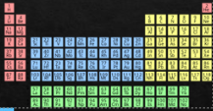
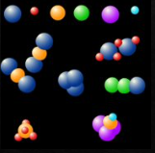
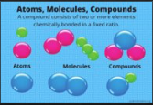
Elements!!!​Elements!!!​
There are 118 elements on Earth, But only 92 occur naturally, others are made by scientist in Labs.

Slide 9
Cont….​
Eg: Sugar, salt, chalk, water, ….​
They all are formed by different molecules, that’s why… the Sugar is sweeter and the Salt is salty.​
It is Fascinating where the two gases elements join to form the liquid Water.​
The Two poisonous substances Sodium and Chlorine combine to from Common salt​
(Sodium chloride). ​

Slide 10
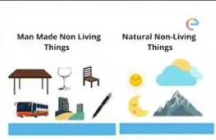
Classification
Living and Non living things.​
Differ in shape, colour, size, etc​
Solid, liquid, gas, micro organisms, etc.​
Grouping together things with similar properties is called Classification.​
Living things Non living things​
​

Slide 11
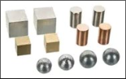
s​Properties of Materials​
Size, shape, colour, texture and smell are properties of matter.​
The properties of materials decide what things we can make out of them.​
Eg: We cannot make cooking utensils out of wood as they will catch fire. ​
Appearance: Iron is different from Aluminium, Aluminium is different from copper. But they are some similarities. But not the paper or wood.​
​

Slide 12
Cont….
Lustre : Metals are more lustre than silk cloth and woolen cloth.​
Iron lustre can be made by rubbing it with the sandpaper if it is rusted.​
Texture: Different materials have different when you touch.​
Eg: wool is soft and metal is hard.​
State: Three types solid, liquid and gas.​
LSolid: They do not change their shape or volume.​
Liquid: They change their shape but not volume.​
Gas: They change their shape and volume. ​

Slide 13
Arrangements of Molecules

Slide 14
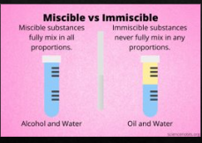
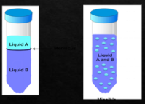
Solubility in Water!​
When sugar is added in water they brake the sugar crystal into very small pieces where they are not visible and so we say that the sugar is Soluble in water.​
Liquids are of two types.​
​

Slide 15
Miscible liquid and Immiscible liquid

Slide 16
Cont…
Miscible: Things like milk, sugar, salt, honey dissolve completely in water.​
Immiscible: Things like the sand, oil, kerosene, etc does not dissolve in water.​
Gases like the Carbon dioxide and Oxygen dissolve completely in water.​
But Nitrogen does not dissolve in water.​
​
Density: The mass per unit volume of a substance is known as density.​
https://youtu.be/2dyCe1GPagE
​

Slide 17
Transparency – Amount of light passing through the material.​

Slide 18
Thank you!!!

